Slide 1
Memory in Context
Jack Gabel, Sol Markman, Quilee Simeon & Hokyung Sung

Slide 2
Who wants to test their memory?
Notes:
We will first present you with 15 target words to try to remember. Then we will present you with 5 distractor words.
Notes:
All words are 5 characters or less and randomly generated.

Slide 3
swing

Slide 4
smile

Slide 5
daisy

Slide 6
frog

Slide 7
crab

Slide 8
oval

Slide 9
rain

Slide 10
legs

Slide 11
eyes

Slide 12
float

Slide 13
hand

Slide 14
jail

Slide 15
fly

Slide 16
bat

Slide 17
whale

Slide 18
fish

Slide 19
king

Slide 20
coat

Slide 21
dog

Slide 22
ghost

Slide 23
Recall time!
Notes:
Log of responses
TARGETS
—
1. swing
2. smile
3. daisy
4. frog
5. crab
6. oval
7. rain
8. legs
9. eyes
10. float
11. hand
12. jail
13. fly
14. bat
15. whale
—
DISTRACTORS
—
16. fish
17. king
18. coat
19. dog
20. ghost

Slide 24
Context reinstatement and episodic memory
Context: “the events surrounding a target event, and the thoughts they evoke” (Manning et. al. 2011)
A quality of episodic (as opposed to semantic) memories
Contiguity effect: items/stimuli presented around the same time tend to be recalled together (temporal clustering)
Notes:
When people recall a past event, they not only recover the features of the event itself, but also recover information associated with other events that occurred nearby in time.
The events surrounding a target event, and the thoughts they evoke, may be considered to represent a context for the target event, helping to distinguish that event from similar events experienced at different times.
Contextual reinstatement underlies the contiguity effect: people’s tendency to successively recall items that were presented in nearby positions on a studied list.
Context representations are composed of many features that may reflect environmental cues, recently studied items, participants’ internal mental states, or may evolve randomly over time.
During recall, the context representation forms part of the retrieval cue, enabling us to distinguish list items from nonlist items.
Understanding the role of context in memory processes is particularly important in tasks such as free recall, where the retrieval cue is “context” itself.

Slide 25
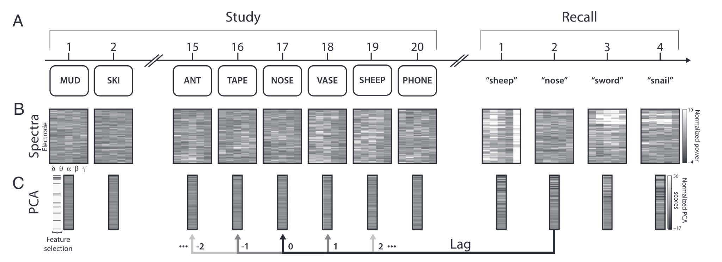
Free recall memory experiment
Manning et. al. 2011
Notes:
Background on paper

Slide 26
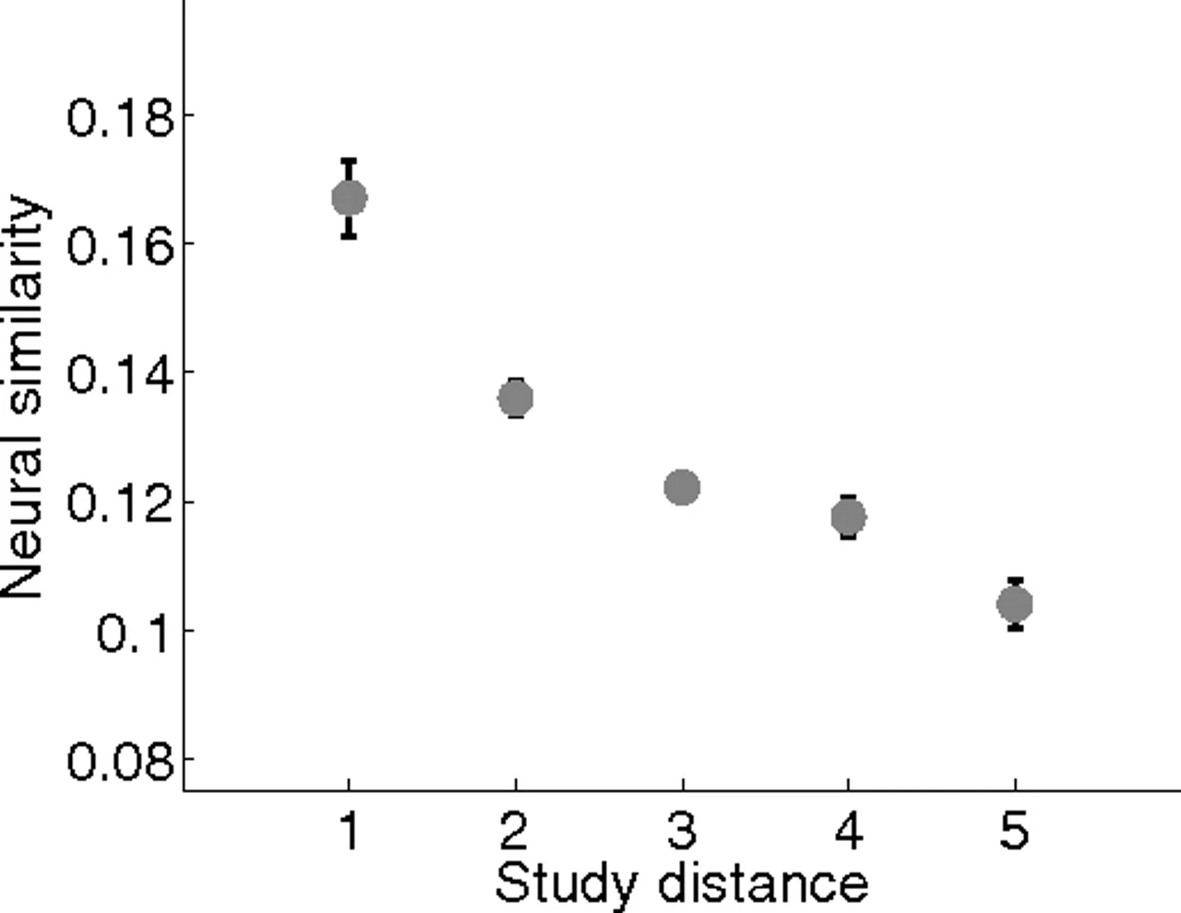
Neural data from human subjects

Slide 27


Modeling Neural Data
One-hot vectors of 20 neurons as corresponding to each presented word
Temporal autocorrelation between overall neural activity (f), modeled as time-weighted average of activity evoked for each timepoint (w)
Autocorrelated Noise model
Only autocorrelation, random one-hot vectors for
Content reinstatement model
During study at time i, w_i is one-hot vectors corresponding to word
During recall at time i of item j, w_i = w_j
Context reinstatement model
Same as content re during study, during recall w_i=f_j

Slide 28
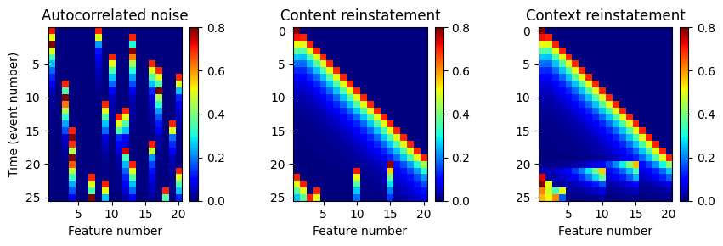
Simulated neural activity over a session

Slide 29
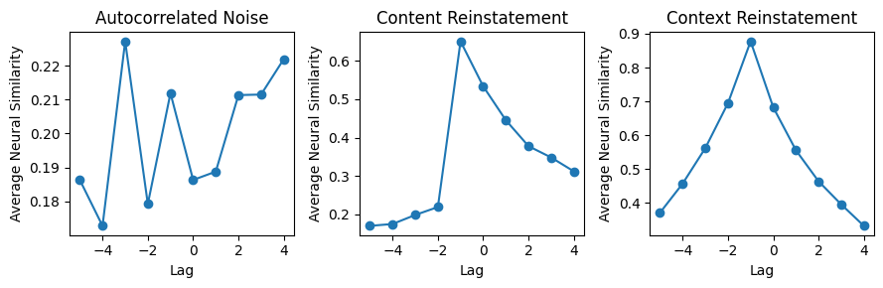
Neural activity similarity over lag for different models
Notes:
The key observation from Howard et al. (2012) was that the neural similarity decreased with increasing absolute lag in both the forward and backward directions, consistent with the idea of a "jump back in time" where the repeated stimulus retrieves the context from its initial presentation. The plot produced by this code should capture this bidirectional contiguity effect, with a peak in similarity around lag 0 (the first presentation of the repeated stimulus) and decreasing similarity for stimuli further away in either direction.

Slide 30
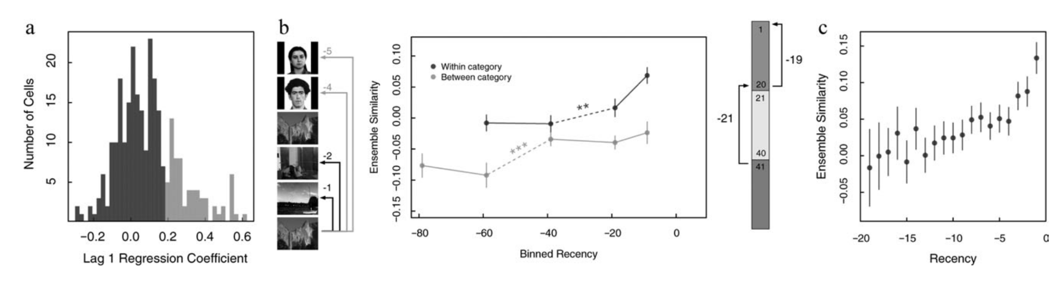
Recognition experiment
Howard et. al. 2012
Have you seen this image before?
YES/NO
Notes:
Q: Does the neural result hold 1) with single-unit recordings from MTL (as opposed to intracranial electrodes) 2) with experimentally controlled stimulus repetitions, rather than free recall?
Fig 3: Quantification of the temporal autocorrelation of MTL ensembles

Slide 31
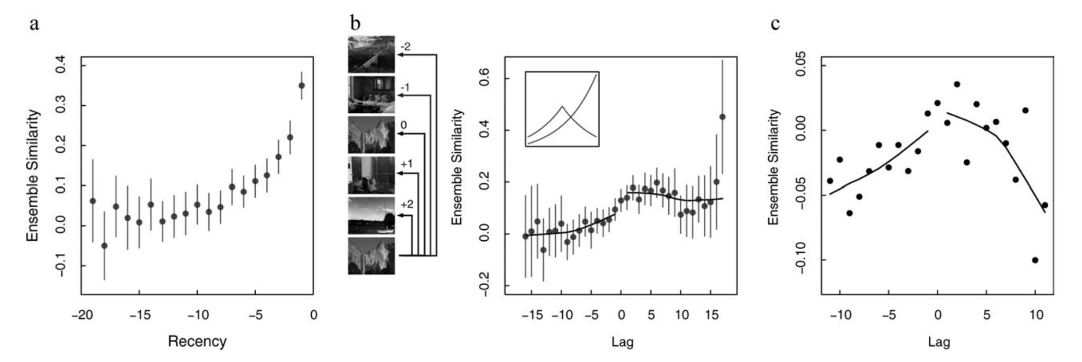
Recognition experiment
Howard et. al. 2012
Notes:
Fig 4: MTL ensembles show the neural signature of a jump back in time
Recency superimposed on contiguity effect

Slide 32
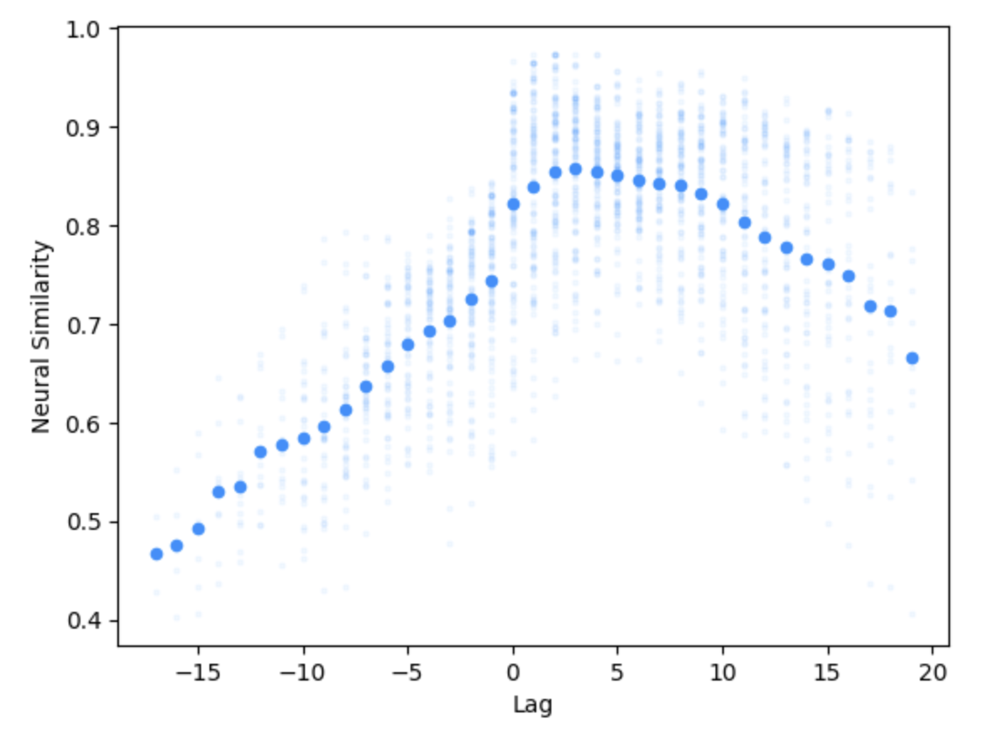
Recognition simulation
Recency effect
+
Contiguity
β=0.4 (drift rate)

Slide 33
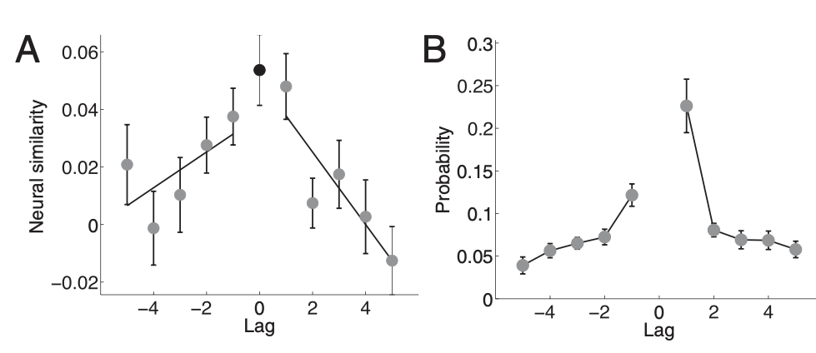
Neural symmetry vs. behavioral asymmetry

Slide 34
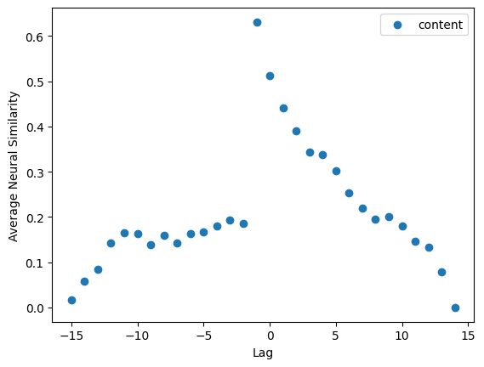
Neural symmetry vs. behavioral asymmetry
The authors only study autocorrelated features of neural data, which favors context rather than item representations
Brain modularity?
Context model could give the recalled item a ‘boost’
Content reinstatement alone produces asymmetry
Notes:
Question 3: Discuss why neural similarity shows forward-backward symmetry, but the free recall data show an asymmetry. How can the temporal context model account for this?
SUMMARY/TL;DR: The symmetric neural reinstatement of context represents the similarity signal, but it is the asymmetric nature of the contextual retrieval process that determines the forward bias in participants' recall transitions. The temporal context model can reconcile the symmetry in neural patterns with the behavioral asymmetry by proposing that context retrieval is asymmetrically weighted towards future contexts
—
The neural data showed that when recalling an item, the pattern of neural activity was similarly graded for items studied before (negative lags) and after (positive lags) the recalled item. In other words, the neural similarity decreased symmetrically with increasing distance from the recalled item in both forward and backward directions.
However, the behavioral free recall data exhibited an asymmetry - participants were more likely to successively recall items studied in the forward direction (from earlier to later list positions) compared to the backward direction.
The temporal context model can account for this discrepancy between the symmetric neural pattern and the asymmetric behavioral recall pattern. According to the model:
1) Items become associated with a gradually changing representation of temporal context during encoding.
2) During recall, the retrieved context cues memories for neighboring items from the original study episode.
3) Critically, the model proposes that while the neural similarity to context is symmetric around a recalled item, the retrieved context itself contains more information from items studied after the recalled item compared to before it.
4) This asymmetry in the retrieved context information drives the forward asymmetry seen in participants' transitions during free recall. The context retrieved by an item preferentially cues memories for items studied later rather than earlier.
.

Slide 35
Discussion Questions
Would this finding generalize to more complex, continuous memories?
Would other brain areas show asymmetry?
What is the recall mechanism and might this affect behavioral asymmetry? How is the encoding and recall process similar and/or different?

